Slide 1
BN304 Industry Based Project 2 Project: Kids Safeway IoT device
FINAL PRESENTATION
TEAM MEMBERS:-
Names | MIT ID’S
Mohamed Manzoor | MIT174788
Anuki Fernando | MIT183321
Saugat Dangal | MIT190140
Keshav Adhikari | MIT191431

Slide 2
CLIENT DETAILS
Company Name: BRR Technology
ABN: 95 423 604 661
Company address: 21/296 Marrickville Rd, Marrickville NSW 2204
Company Profile: Full-service technology consultancy company delivering high performing and advanced functionality software solutions for growing companies.
Industry Assigned Supervisor Detail
Contact Name: Mohammad Al Khalili
Email id: projects@careerdc.com.au

Slide 3
CONTENT
Client requirements
Problem domain & Project objectives
Project requirement analysis
Block & information flow diagram of the system
Research questions
Project plan and design
Step by step procedure
Equipment’s used & Limitations
Conclusion & future work

Slide 4
CLIENT REQUIREMENTS
Create a tracking device using Arduino & GPRS shield.
Small and light weighted.
Long-lasting battery life.
Should inexpensive to manufacture.
Should be easy to setup without taking much time.
Parents should get kids live location when a text message is sent by them to tracker.

Slide 5
PROBLEM DOMAIN
In this fast growing generation, many kids come across a lot of issues regarding their safety when they step outside their home.
We focus on the issues faced by small kids such as road accidents, kidnapping and harassments.
A lot of road accidents occur during school hours which increases the risk for school kids on their way to school or back home.
Parents are really concerned about such issues and want to keep a track on their kids.

Slide 6
PROJECT OBJECTIVES
The report objective is to design and implement a tracker device to monitor journey of children back and forth from home to school.
Accurate implementation is needed on how we can build the kids safety IoT device with features like monitoring live location sending SMS and emergency alerts.
Location information can be accessed by kids guardian with the help of GSM cellular network.
In this In the end, we’d be ready with a structured device that will be durable with no errors and would generate accurate location through SMS.

Slide 7
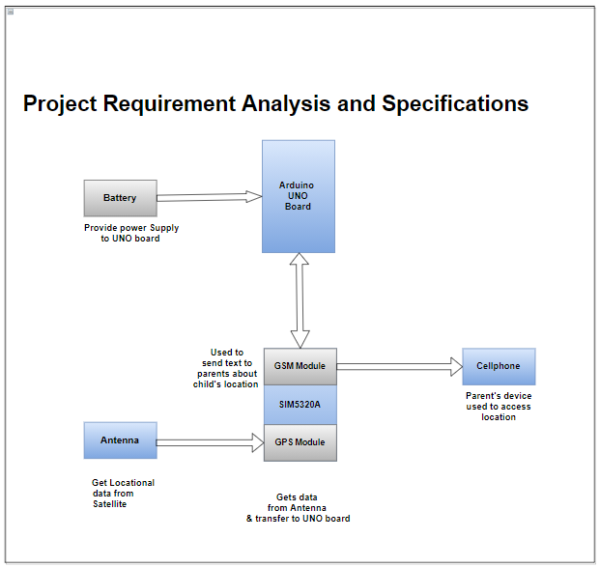
PROJECT REQUIREMENT ANALYSIS AND SPECIFICATIONS
Figure 1 explains how equipment are interconnected in the device.
Arduino Uno board is connected to battery, GPS and GSM.
GPS is the Global Positioning System, and it gets the data from Antenna.
GSM is the Global System for mobile communication and is responsible for message transmission.
Figure 1 Block diagram of device

Slide 8
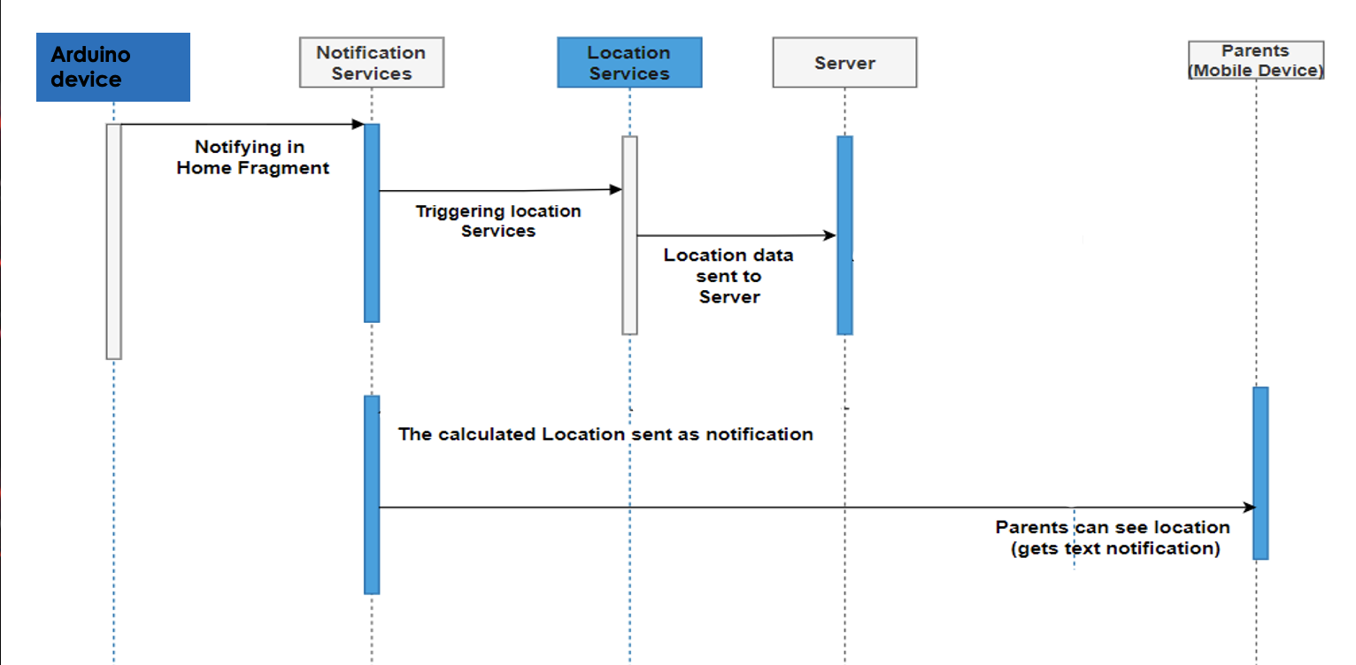
INFORMATION FLOW DIAGRAM
Figure 2 is the Information Flow Diagram of Device.
The diagram explains working mechanism of device sequentially
Device notifies the home fragment.
Locational information is sent to the server.
The calculated location is sent to the notification services and can be accessed by parents.
Figure 2 Information flow diagram

Slide 9
RESEARCH QUESTIONS
1. Working mechanism: What kind of modification and programming can be done to the sensors used in the device for collecting accurate data from them.
2. Precision in Location Tracking: Identify the challenges related to the connection loss because of poor cellular connection and device failure.
3. Compatibility and connection: What can be done to overcome the issues related to the stable connection and compatibility of the device with present smart devices.
4. Device Durability: How the proper selection of embedded sensors and batteries helps in the long-term use of the device.

Slide 10
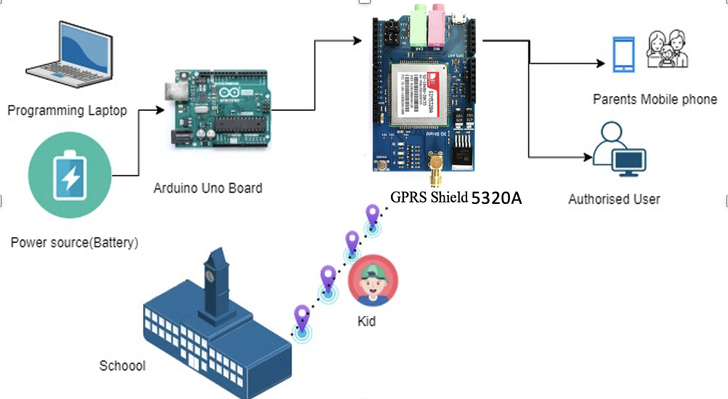
PROJECT PLAN AND DESIGN
In the Arduino UNO board, the battery support providing power to the device.
The important components of the device are GPS and GSM modules.
GPS provides the location and translate into the map. GSM provides the cellular network to device to operate on its on data rather than switching to area network.
Thus, with the help of the device mentioned parents can track the location of their child which going to school and can check the real time location and movement of child.
Figure 3 work diagram

Slide 11
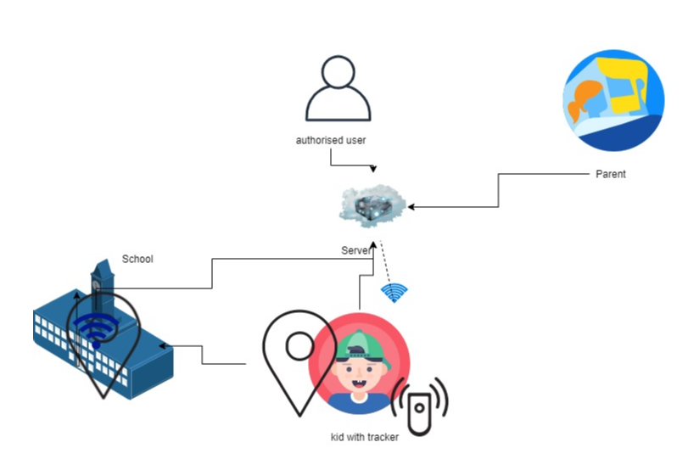
PROJECT PLAN AND DESIGN
The previous image shows kid is travelling to the school and the location is updating through the GPS module complied with the gsm to keep the user updated for the location.
The location can be accessible to the user or the parent as the location is updated dynamically over the time.
The working prototype clearly emphasis the passage of the kid location through the SMS notification and shows the real time location.
All the mainframe concept is combined and synched in order to make the project prototype to look exactly similar with the end device.
Figure 4 Conceptual design 1.1

Slide 12
DEMONSTRATION VIDEO
Link : https://youtu.be/akgJmYPwBLk

Slide 13
STEP BY STEP PROCEDURE
Step 1
Connecting Arduino UNO to GPRS Shield
Step 2
Connecting Arduino UNO to power source(5V battery)
Step 3
Coding of Arduino Board using Sketch(C++)
Step 4
Real time testing of the device.

Slide 14
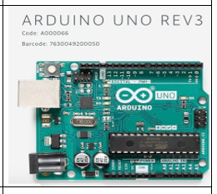
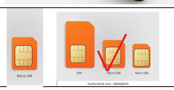
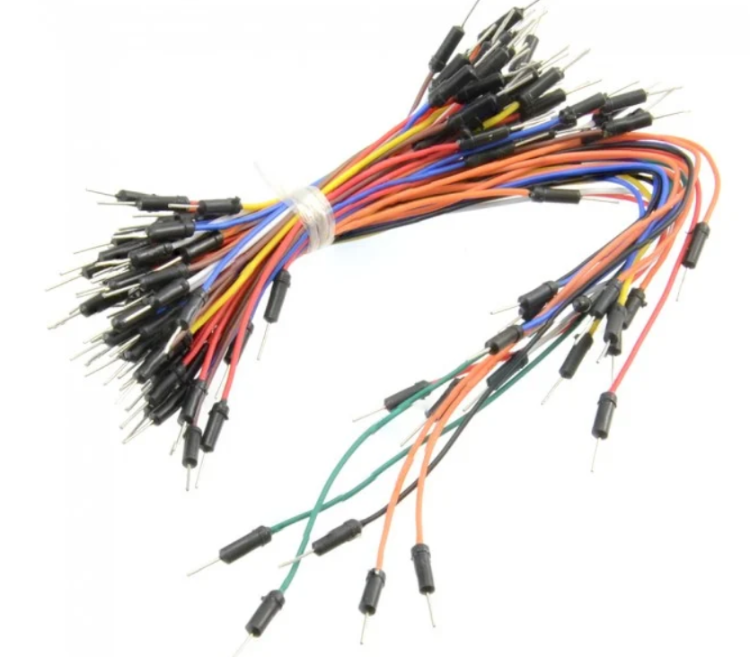
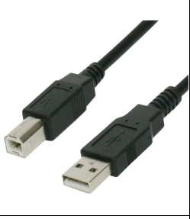
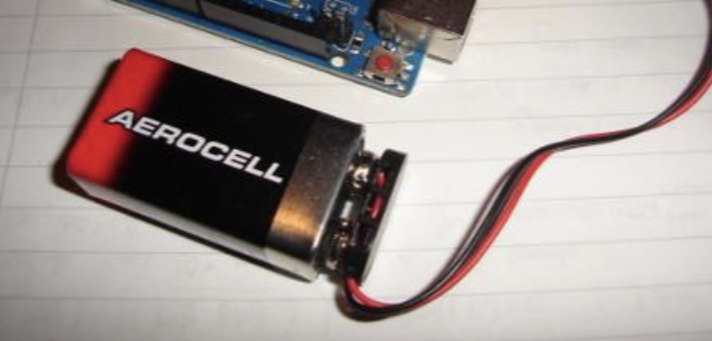
EQUIPMENTS
Arduino UNO REV3
GPRS SHIELD SIM 5320A
Micro sim
Connecting wires
USB Cable Type A/B
5V Battery

Slide 15
LIMITATIONS
Tracking is extremely difficult to track in bad weather.
If travelling in fast moving vehicle the device communication will be lagging.

Slide 16
CONCLUSION
Kids safety is a major concern of parents main purpose is to implement a kids safeway IoT device.
Final device gives the exact location upon the request sent by the parent.
The GPRS shield helps in sending a live location to parents by a SMS.
This device will improve child safety and reduce the fear of parents.
Arduino will be used as the microprocessor as it is cheap and convenient.

Slide 17
FUTURE WORK
The physical size and dimensions of the device can be adjusted according to the user demand.
Additional features such as heart rate calculation, temperature etc. can be included to bring value to the device.
To have an option of installing an emergency button.
The device can be made compact.

Slide 18
.
ANY QUESTIONS?
Thank you

